Slide 1
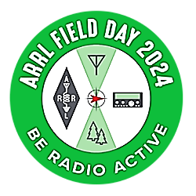

Slide 2
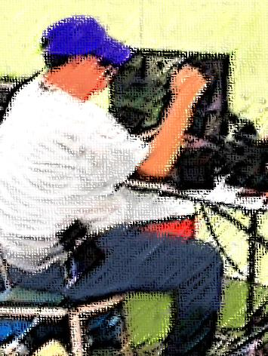
Amateur radio operators have been transmitting from “the field” since the early 1900S.
More than 160 countries world-wide hold Field Days. North American Field Day is always held annually
On the fourth full weekend in June .

Slide 3
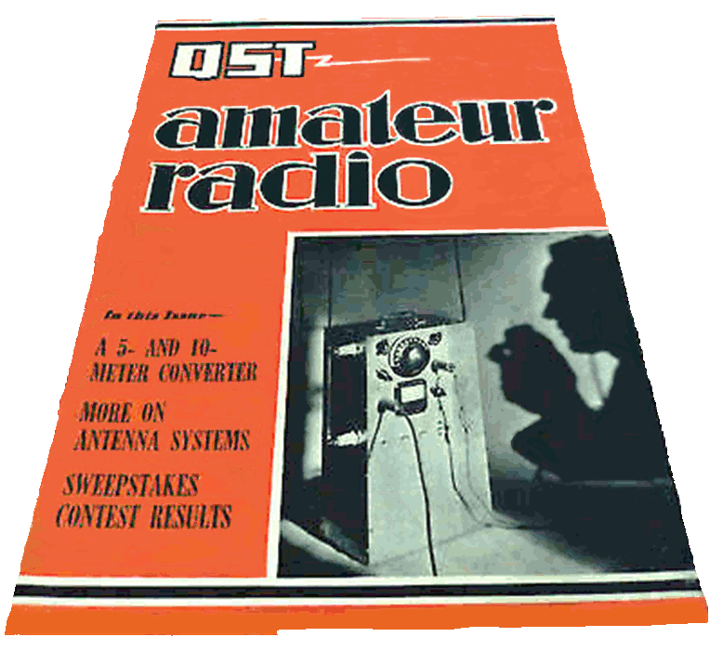
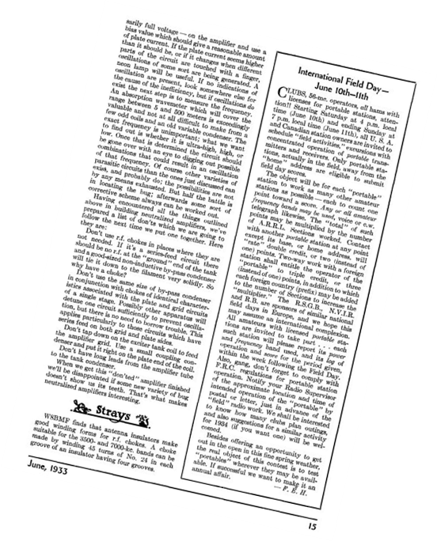
The first “international field day” for U.S. and Canadian hams was announced in the June, 1933 issue of
ARRL’s magazine, QST.
All clubs and hams with licenses for portable stations could submit
Field Day scores.
The concept of an organized Field Day was so new, QST asked its readers to report back and offer suggestions for a similar activity in 1934
“if you want one.”

Slide 4
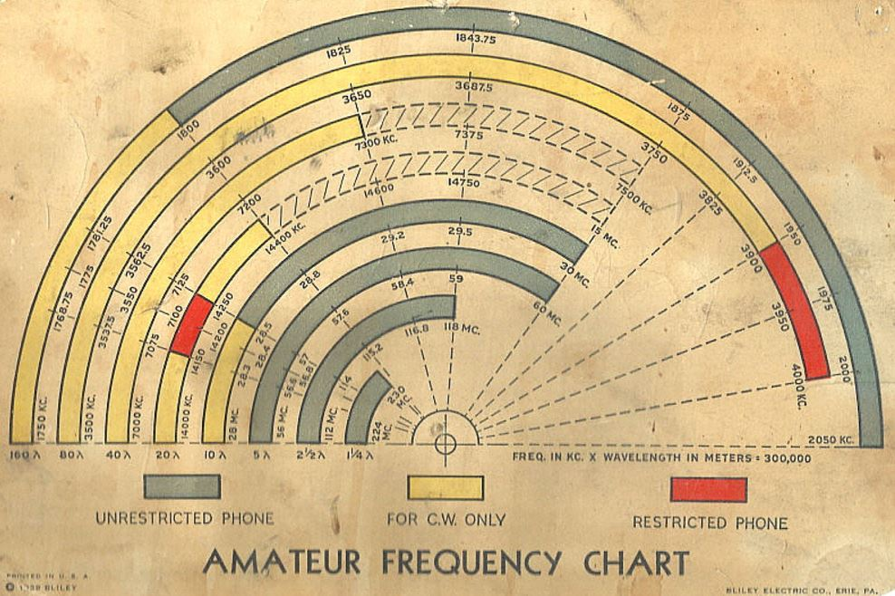
IN 1934 THE FEDERAL COMMUNICATIONS COMMISSION WAS CREATED BRINGING WITH IT REORGANIZATION OF AMATEUR RADIO LICENSING.
The new FCC Rules Created three classes of amateur licenses, all requiring basic or advanced knowledge of theory and regulations and an ability to send and receive code.
by 1936, there were 46,000 licensed hams; by 1939, 51,000.

Slide 5
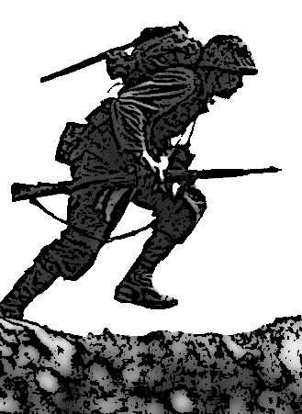

In june, 1940, with the U.S. on the verge of entering World War II , the FCC banned amateur radio communications with foreign stations.
Portable and mobile operation below 56 megacycles was halted (except for 1940 ARRL FIELD DAY). the last pre-WWII Field Day took place on June 7 & 8, 1941.
All licensees were required to send a set of fingerprints, a photo, and proof of citizenship to the FCC.
On December 7, 1941, the United States entered the war. Amateur radio operators were immediately ordered to go off the air.
The ban lasted until war ended in 1945. some bands were not reopened until 1946.

Slide 6
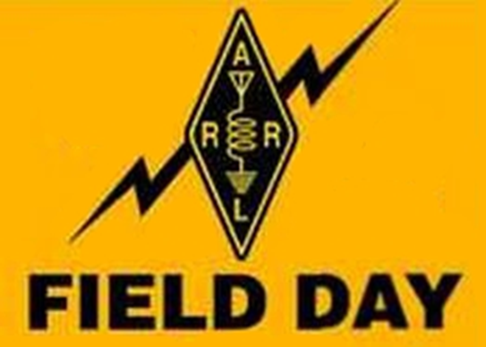
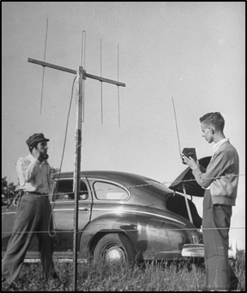
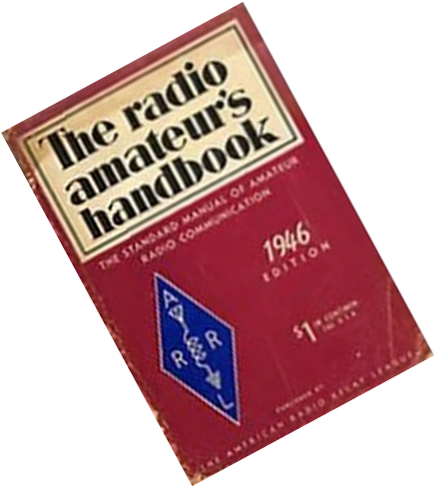
After V-J DAY, September 2, 1945, hams were able to operate on the 2 1/2 meter band. Two months later, the FCC released the 10, 5, and 2 meter bands for amateur use.
ARRL Field Day resumed in 1946, with more portable radio equipment and new field day rules that helped the annual event grow in size and scope.
THE 1946 Field Day drew 104 club groups , 53 non-club groups and individuals and 45 home stations participated.

Slide 7
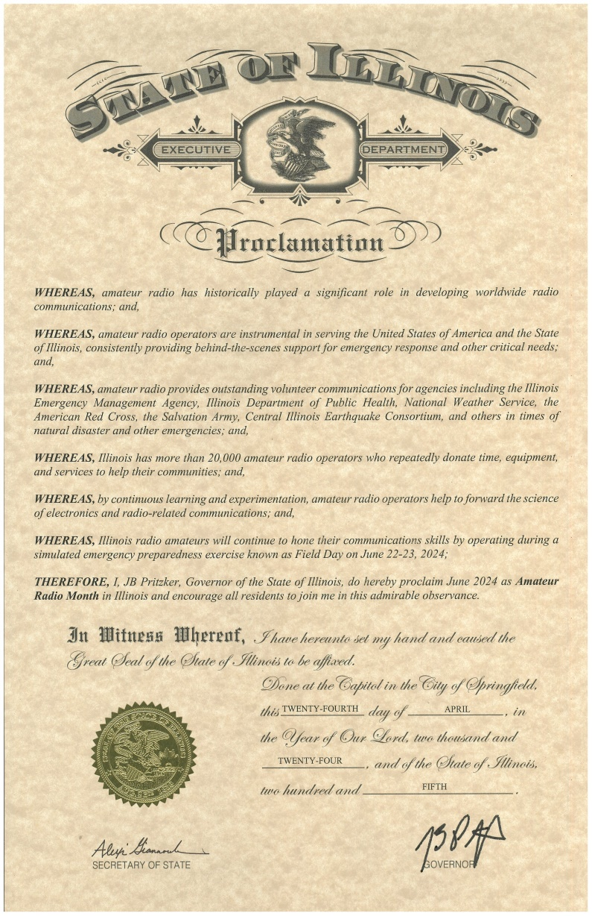
FIELD DAY IS A BIG
DEAL IN ILLINOIS!
ARRL FIELD DAY HAS BEEN OFFICIALLY RECOGNIZED
BY THE STATE WITH A PROCLAMATION ISSUED BY THE GOVERNOR DESIGNATING JUNE 2024 AS “AMATEUR RADIO MONTH” IN ILLINOIS.
NUMEROUS LOCAL MUNICIPALITIES ACROSS ILLINOIS HAVE JOINED IN WITH LOCAL PROCLAMATIONS CITING THE ROLE AMATEUR RADIO PLAY IN THEIR COMMUNITIES.

